Slide 1

Healthcare Analytics For Doctor Visit TIRTC
AICTE Reg no : STU6a6ccd17eea6d1785515287
Name : Dhanaseelan R
Collage Name : SASTRA Deemed to be University

Slide 2

PROBLEM STATEMENT
Operational Inefficiency: Healthcare facilities face unpredictable patient footfall and staffing imbalances due to a lack of visibility into what drives outpatient visits.
Resource Misallocation: Without identifying whether visits are triggered by immediate symptoms, chronic conditions, or insurance access, providers risk overstaffing or under-serving high-need patients.
Objective: Analyze patient data to isolate the key factors influencing doctor visits, enabling accurate demand forecasting and targeted clinical resource allocation.

Slide 3
Project Description
Data Scope: Evaluated 5,190 patient records across 12 demographic, socioeconomic, and clinical attributes.
Core Metrics: Analyzed total doctor consultations (visits) alongside key drivers such as days of reduced activity (reduced), acute illnesses (illness), chronic health conditions, and insurance coverage models.
Methodology: Performed data cleaning, categorical normalization, engineered features for visit occurrences and chronic illness types, and mapped behavioral patterns through statistical distributions and correlation matrices.
Goal: Identify the primary factors that prompt medical consultations to inform capacity planning and targeted patient care

Slide 4

WHO ARE THE END USERS?
1. Hospital & Clinic Administrators:
  Forecast patient footfall and schedule physician shifts more effectively based on acute symptom prevalence and high-utilization groups.
2. Health Insurance Providers & Underwriters:
  Design risk-stratified premium tiers and wellness plans targeted at members with activity-limiting conditions.
3. Public Health Policy Makers:
  Assess whether government welfare and subsidized medical access programs are adequately reaching disadvantaged and veteran cohorts.
4. Chronic Disease Care Managers:
  Target preventive outpatient interventions to reduce acute symptom flare-ups and unnecessary frequent clinical visits.

Slide 5

Technology Used
Environment: Google Colab (Python)
Data Processing: Pandas & NumPy (data cleaning, grouping, and feature engineering)
Data Visualization: Matplotlib & Seaborn (bar charts, pie charts, and correlation heatmap)

Slide 6
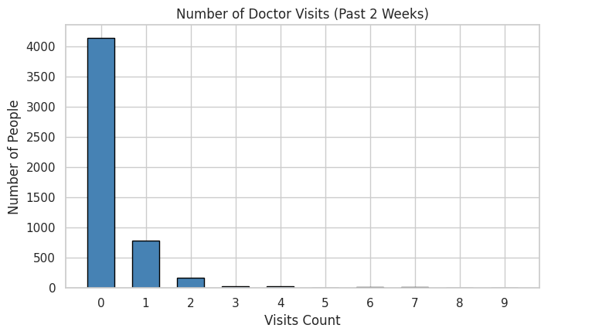
RESULTS
About 79.8% of people (4,141 individuals) had zero doctor visits, showing most did not need care in the two-week period. Only 15.1% (782) visited once and 5.1% (267) visited two or more times, highlighting a steep drop in frequent care utilization.
Github link: https://github.com/dhanaseelan-r4/Healthcare-Analytics-For-Doctor-Visit-.git

Slide 7
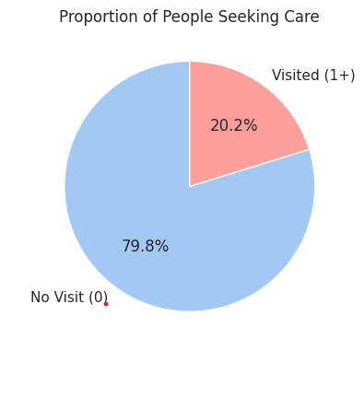
RESULTS
Around 79.8% of individuals (4,141 people) did not visit a doctor during the two-week timeframe. The remaining 20.2% (1,049 people) sought medical care with one or more visits, showing that roughly one in five respondents used healthcare services.
Github link: https://github.com/dhanaseelan-r4/Healthcare-Analytics-For-Doctor-Visit-.git

Slide 8
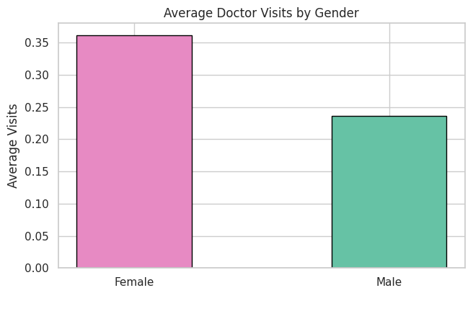
RESULTS
Female patients averaged approximately 0.36 doctor visits, compared to 0.24 visits for male patients over the two-week period. This indicates that women sought medical consultations about 53% more frequently than men in this surveyed population
Github link: https://github.com/dhanaseelan-r4/Healthcare-Analytics-For-Doctor-Visit-.git

Slide 9
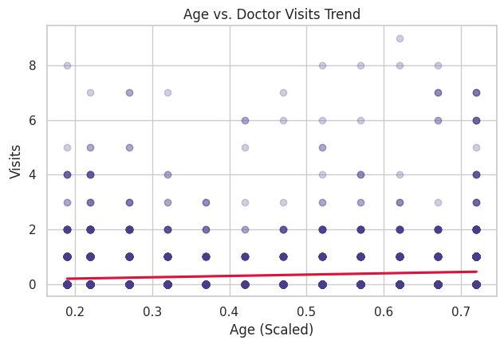
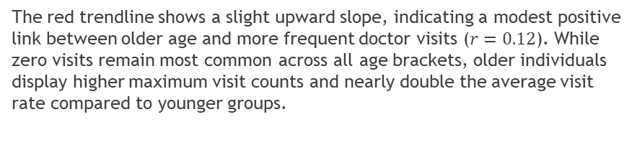
RESULTS
The red trendline shows a slight upward slope, indicating a modest positive link between older age and more frequent doctor visits ($r=0.12$). While zero visits remain most common across all age brackets, older individuals display higher maximum visit counts and nearly double the average visit rate compared to younger groups.
Github link: https://github.com/dhanaseelan-r4/Healthcare-Analytics-For-Doctor-Visit-.git

Slide 10
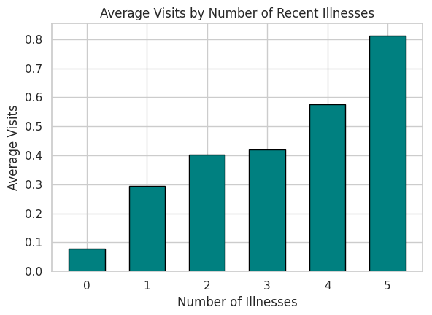
RESULTS
Average doctor visits climb steadily as recent illnesses increase, rising from under 0.1 visits for zero illnesses to over 0.8 visits for five illnesses. This demonstrates a strong direct relationship where patients with multiple simultaneous health issues seek medical care far more often.
Github link: https://github.com/dhanaseelan-r4/Healthcare-Analytics-For-Doctor-Visit-.git

Slide 11
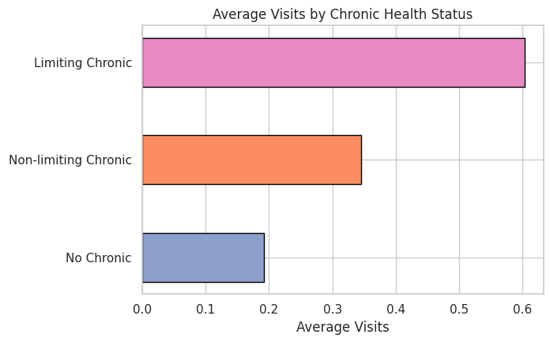
RESULTS
Patients with limiting chronic illnesses have the highest consultation rate at roughly 0.60 visits, compared to 0.35 for non-limiting conditions and just 0.19 for those with no chronic conditions. This shows that health conditions which actively restrict daily life more than triple doctor visit frequency.
Github link: https://github.com/dhanaseelan-r4/Healthcare-Analytics-For-Doctor-Visit-.git

Slide 12
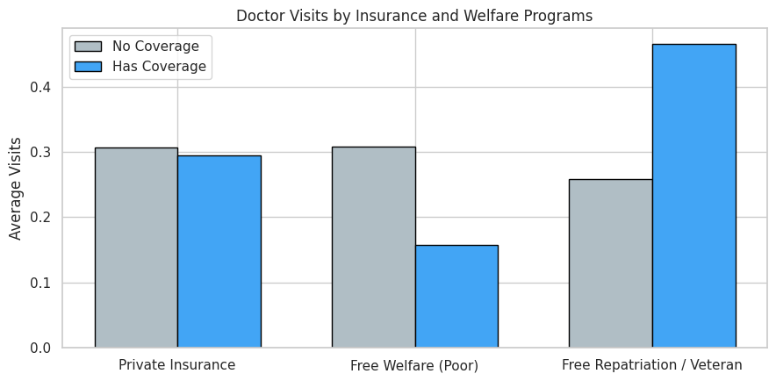
RESULTS
Free repatriation and veteran coverage shows the highest consultation rate at roughly 0.47 visits compared to 0.26 without coverage. Meanwhile, private insurance shows nearly identical visit rates (~0.30 visits regardless of coverage), and low-income welfare recipients average fewer visits (0.16 vs. 0.31).
Github link: https://github.com/dhanaseelan-r4/Healthcare-Analytics-For-Doctor-Visit-.git

Slide 13
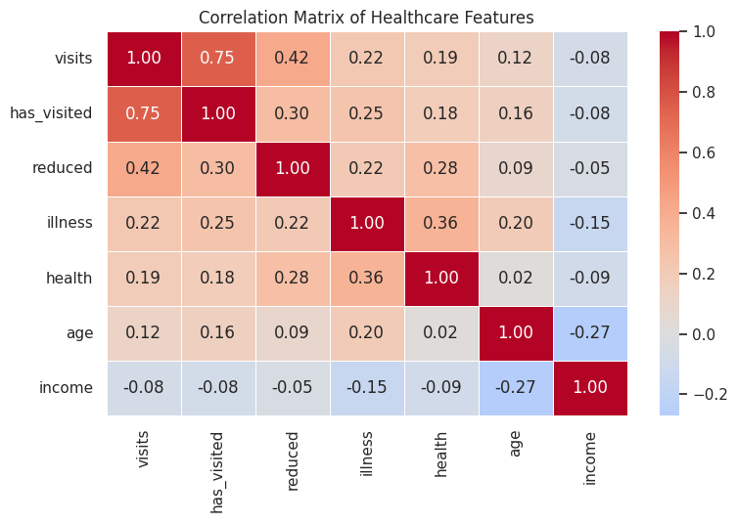
RESULTS
Days of reduced activity (reduced, 0.42) and illness count (illness, 0.22) show the strongest positive correlation with doctor visits, proving immediate health limitations drive care-seeking most. In contrast, age (0.12) and health score (0.19) have weak links, while income has a slight negative correlation (-0.08).
Github link: https://github.com/dhanaseelan-r4/Healthcare-Analytics-For-Doctor-Visit-.git

Slide 14
Thank you
I appreciate your time and attention. It was a pleasure presenting this analysis.
.
.

